Slide 1

Ambulance Alert System

Slide 2

Problem Statement
According to a report published by Times of India about 146,133 people were killed in road accidents in India in year 2016.
Unfortunately, about 30% of deaths are caused due to delayed ambulance because of traffic congestion,
Also, according to another data of government more than 50% of heart attack case reaches hospital late, Which can constitute unavailability of ambulance too but majority of it is due to ambulance stuck in traffic.

Slide 3
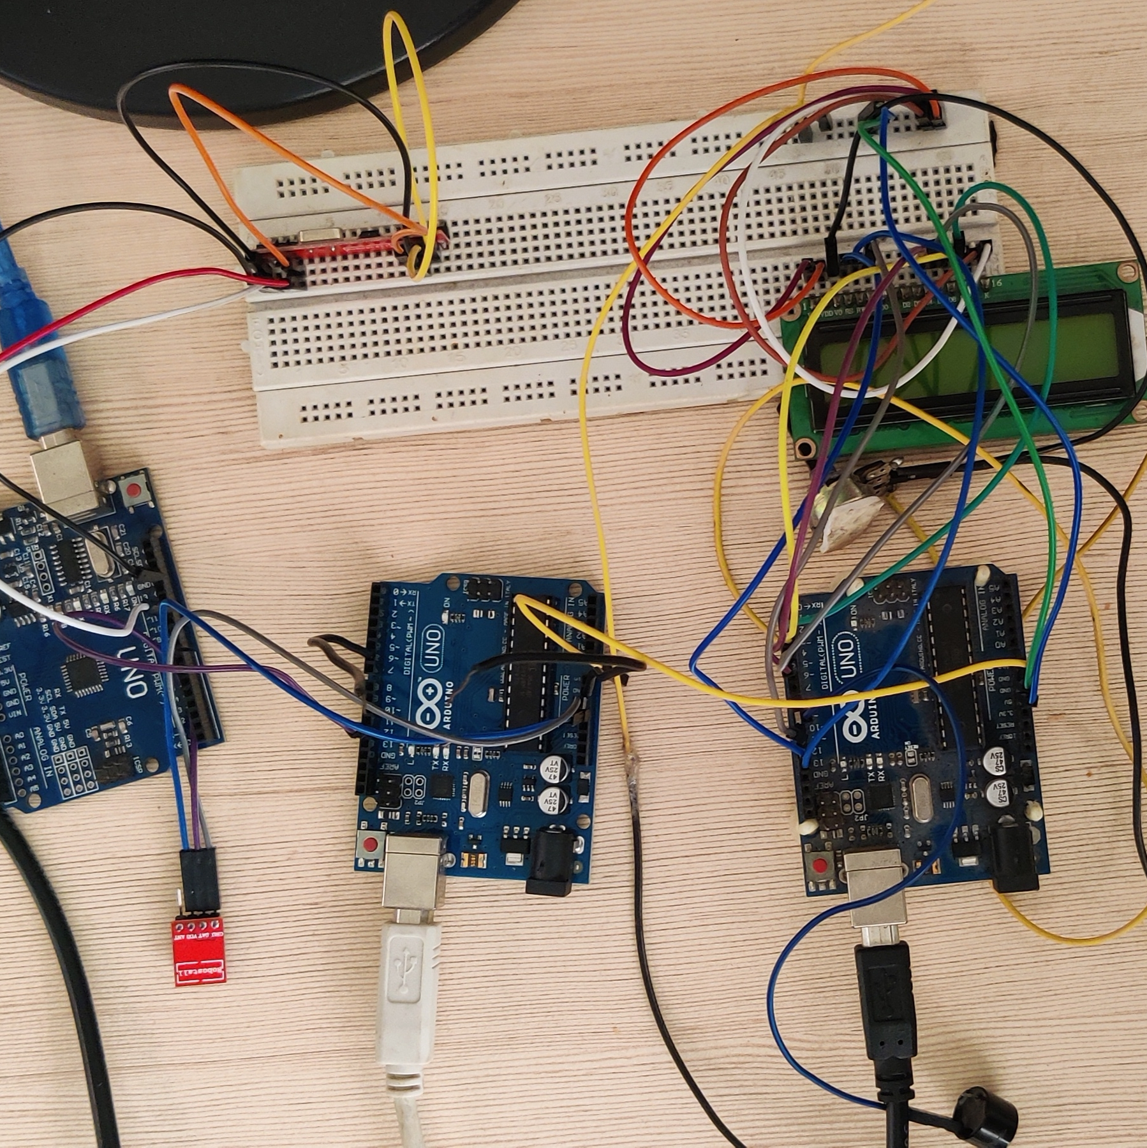
Proposed Solution
Ambulances to have a special system which would help them to connect to the nearest traffic signal and pop up a sign on timer , To pre-inform the vehicle drivers about the upcoming ambulance
Ambulance Alert System Works on the principle of Radio Frequency and uses some path determination and path optimization algorithms to guide ambulance.
Ambulance alert system will be a ready to use kit which needs only power supply which will provided by battery which will be using solar power for charging. It is a 2-part device called as transmitter and receiver.
This is our fourth patent technology; we already have 3 GRANTED INDIAN PATENTS.
PROTOYPE 2.0 ( T.R.L 3)
CLICK HERE to view PROTOTYPE 3.0 in action.

Slide 4

Working of AAS.
Area set is taken let’s suppose of 1 km radius, The device scans traffic and whichever path is best is prompted and a green route is achieved with no or little human intervention
If Traffic Signal has timer, then process begins, and A sign is prompted on the signal every odd second Otherwise just the A signal comes, and buzzer is blared.
As ambulance crosses the path the system is turned back to normal

Slide 5

Applications and Features
An easily implementable and unique solution to create a green corridor.
A state-of-the-art system which can be used to detect any emergency and reduce it accordingly.
To catastrophically reduce fatality rates in road accidents.
Extremely portable and economic to implement in auto manufacturing units
To introduce a spectacular system in the realms of BS norms.
AI Based system to detect the behaviour of serial law breakers

Slide 6
Usability
A state-of-the-art system which can be used to detect any emergency and reduce it accordingly.
To be Implemented on Traffic Signals
Available on the get-go
Fully automated system

Slide 7

Team & Achievements
Our team is a perfect blend of Business x Innovation. The innovative solutions are developed, Henceforth the opportunities for business growth and optimization of marketing strategies leading the team’s vision are implemented.
Previously we have developed 3 patented technologies for which we hold :-
AIR 1 In Quest of SDGs (NITI Aayog, AIM)
Provisionally selected for Atal New India Challenge 2.0
Top 5 Chandigarh Police Hackathon (in association with Infosys)
Semi Finalist HUL Innovation café hackathon 2021

